Slide 1


Digitalisation
The ultimate goal (COM(2016)180 final)
To ensure that any industry in Europe, wherever situated and in any sector can fully benefit from digital innovations
European Initiatives
to facilitate digital transformation of SMEs and Mid-caps
Innovation Actions (IA)
H2020 instrument focusing on close to market actions, not research
Cascade Funding allows effective support for SMEs

Slide 2
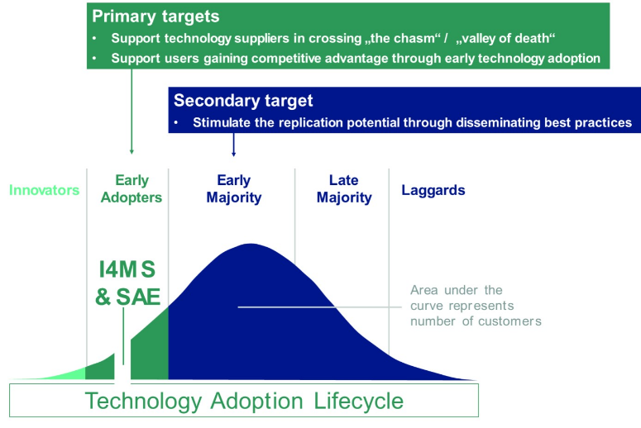
SmartAnythingEverywhere Initiative

Slide 3

SmartAnythingEverywhere Initiative
Innovation Actions (Hubs as one-stop-shops) to provide companies, in particular SMEs, with access to
knowledge & network
resources
training & best practice examples
finance & funding opportunities
in order to enable digital innovation
Experiment and adapt existing technologies to specific needs of SMEs, by running smaller projects (Application Experiments) using cascade funding.
No focus on technology / industry but on soft- and hardware!

Slide 4
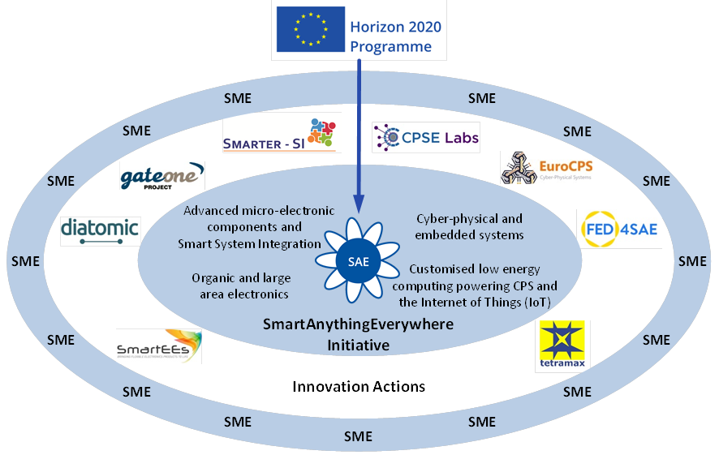

Digital Innovation Hubs Thematic Areas

Slide 5





Areas of Engagement
Area 1: Cyber-physical and embedded systems aims to
uplift the quality and performance of products and services
with innovative embedded ICT components and systems
support eco-system building for promising platforms developed
in earlier R&I products
3 projects with 18 hubs
Open calls by FED4SAE
Area 2: Advanced Computing aims to
develop products for situations where high computing capacity
and low energy would be a competitive advantage
support eco-system building for promising platforms developed in
earlier low power computing projects
2 projects with 41 hubs
Open calls by TETRAMAX

Slide 6




Areas of Engagement
Area 3: Smart Systems Integration aims to
electronic components, sensors, smart objects and systems
access to advanced design and manufacturing for academia,
research institutes and SMEs
rapid prototyping targeting SMEs
3 projects with 15 hubs
Open calls by diatomic
Area 4: Organic and large area electronics aims to
maturing, innovating and validating products with organic and
large area electronics technologies
access to design, technology and prototyping
application experiments driven by concrete user requirements
and business cases
1 project with 9 hubs
Open calls by SmartEEs

Slide 7
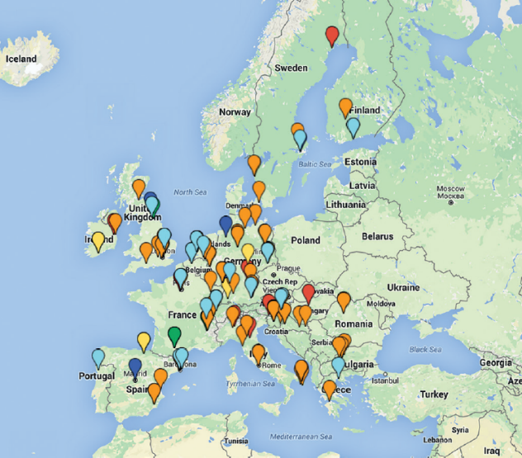






Digital Innovation Hubs in SAE so far



Slide 8































































Digital Innovation Hubs in SAE

