Slide 1
Engage with running SAE projects

Slide 2




Upcoming Open Calls
Area | Project |  | 2018 |  | 2019 |  | 2020
Cyber-physical and embedded systems |  |  | open until 18.09. | Nov. | - |  | -
Customised low energy computing powering CPS and IoT |  | Bilateral | October |  | September |  | April
 |  | Value chain / interdisciplinary | December |  | October |  | April
 |  | Entrepreneurial | August |  | August |  | August
Advanced micro-electronic components and Smart System Integration |  |  | November |  | - |  | -
Organic and large area electronics (cut-off dates) |  |  | Cut-off 16 November |  | Cut-off 19 April | Cut-off 20 Sept. | -

Slide 3

TETRAMAX
Focus
Customized low-energy computing powering CPS and IoT
Mission
Build up and leverage a European Competence Center Network in customized low-energy computing
Provide easy access to novel CLEC technologies
Bidirectional interaction between SME and academia
Offer
support 50+ industry clients and 3rd parties with innovative technologies by using different kinds of Technology Transfer Experiments (TTX)
Fields of Application
HW customization
MEMS
Multicore design
Multimedia processing
Heterogeneous computing
IT security
Wireless communications
Compiler technologies
Open source data generation technologies
Reliability and dependability
SW development
Human/Machine Interfaces
Multicore design
Positioning technology
and many more
www.tetramax.eu

Slide 4

FED4SAE
Focus
Cyber-physical and embedded systems (CPS)
Mission
Accelerating CPS solutions to market by creating a pan-European network to enable startups, SMEs and midcaps to use CPS platforms combined with expertise and know-how from the R&D Advanced Platform
Offer
Provide a complete solution including software and hardware tested in market environment
Support and guidance from conceptual design to market launch
Fields of Application
Smart wellbeing and health
Smart city
Smart manufacturing
Smart transportation
Smart mobility
Smart energy
www.fed4sae.eu

Slide 5
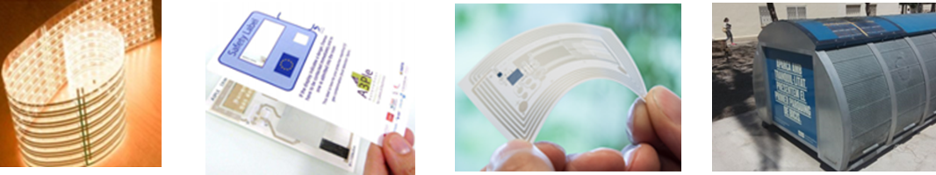
SMARTEES
Focus
Organic and Large Area Electronics (OLAE)
Mission
Create a competitive advantage by providing access to Flexible Electronics technologies & business support for accelerating innovation and digitisation of European SME and mid cap companies
Offer
One-stop-shop for the adoption and integration of Flexible Electronics technologies into novel product concepts
20 Application Experiments to explore the transfer of technology to business through 20 novel product prototypes
Fields of Application
  OLED lighting
  Organic photovoltaics
  Flexible and OLED display
  Electronics & Components and Integrated Smart Systems
www.smartees.eu

Slide 6
DIATOMIC
Focus
Advanced micro-electronic components (AME) and Smart System Integration (SSI)
Mission
From experimentation and prototyping to full-scale commercial deployment: Create a competitive advantage by providing access to disruptive (LAEs) technologies and business support for innovation adoption
Offer
Strong technological support to accelerate novel application development, prototyping & experimentation
Business support to develop solutions with a robust product / market fit and chart the path to market growth
Fields of Application
Health
Agrifood
Manufacturing
www.diatomic.eu

