Slide 1

SmartAnythingEverywhere Initiative
Innovation Actions (Hubs as one-stop-shops) to provide companies, in particular SMEs, with access to
knowledge & network
resources
training & best practice examples
finance & funding opportunities
in order to enable digital innovation
Access and adapt existing technologies to specific
needs of SMEs, by running smaller projects (Application Experiments / AEs) using cascade funding.
AEs focus on software / hardware across technologies and industries

Slide 2
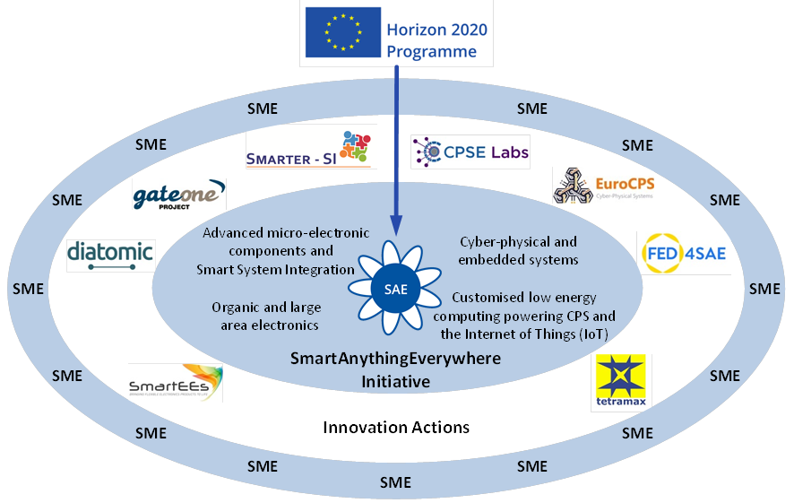

Digital Innovation Hubs Thematic Areas

Slide 3




Areas of Engagement
Area 1: Cyber-physical and embedded systems aims to
uplift the quality and performance of products and services
with innovative embedded ICT components and systems
support eco-system building for promising platforms developed
in earlier R&I projects
3 projects with 18 hubs
Open calls by FED4SAE
Area 2: Customised low-energy computing powering CPS
and the IOT aims to
develop products for situations where high computing capacity
and low energy can provide a competitive advantage
support eco-system building for promising platforms developed in
earlier low power computing projects
2 projects with 41 hubs
Open calls by TETRAMAX

Slide 4




Areas of Engagement
Area 3: Smart Systems Integration aims to
electronic components, sensors, smart objects and systems
access to advanced design and manufacturing for academia,
research institutes and SMEs
rapid prototyping targeting SMEs
3 projects with 15 hubs
Open calls by diatomic
Area 4: Organic and large area electronics aims to
maturing, innovating and validating products with organic and
large area electronics technologies
access to design, technology and prototyping
application experiments driven by concrete user requirements
and business cases
1 project with 10 hubs
Open calls by SmartEEs

Slide 5
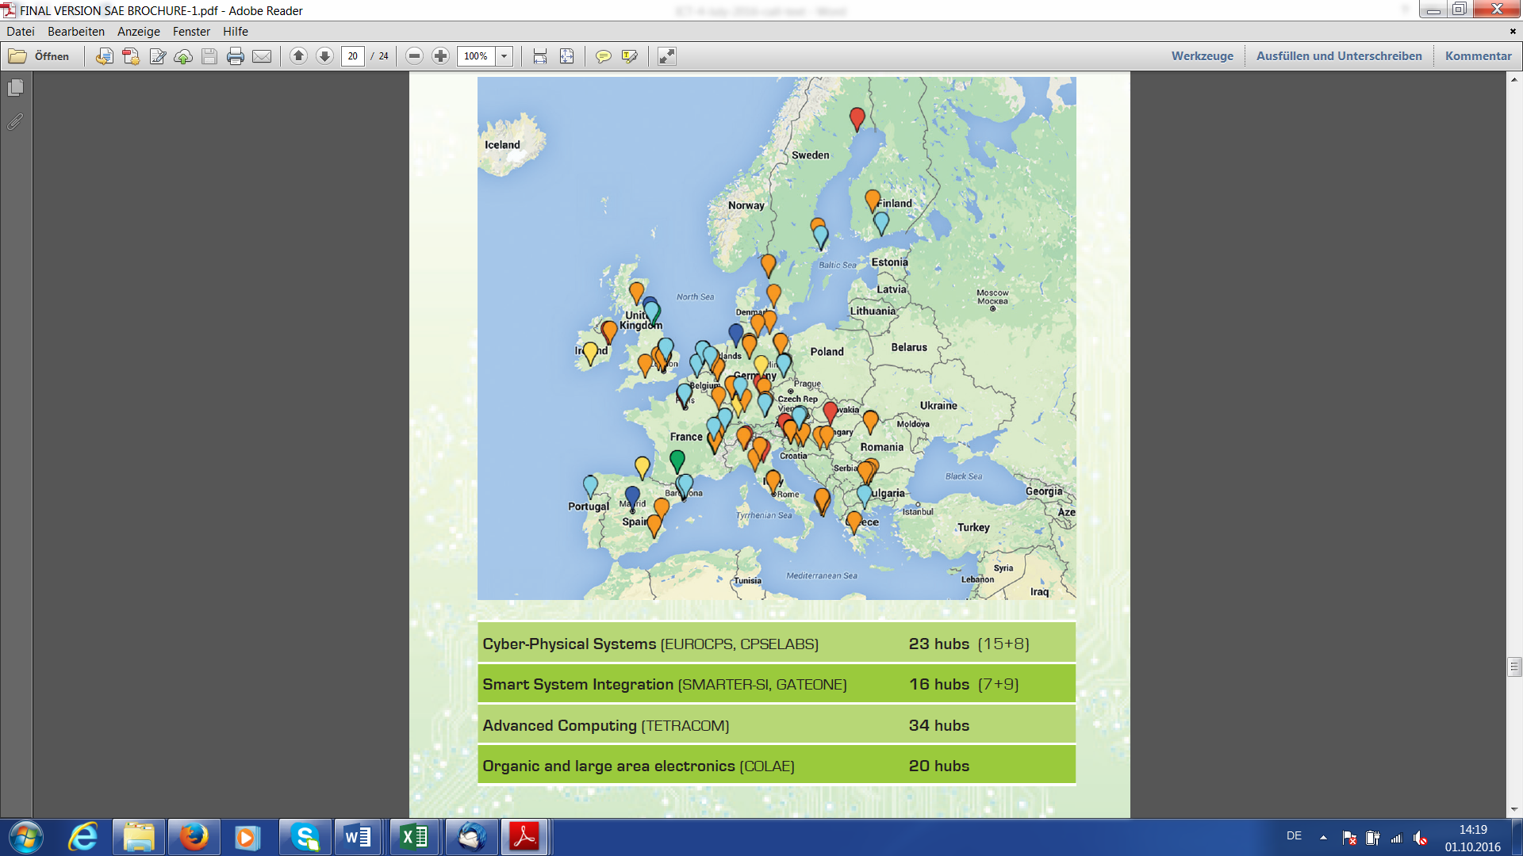




Digital Innovation Hubs in SAE so far



Slide 6



































































Digital Innovation Hubs in SAE

Slide 7
Timelines and Open Calls

Slide 8
Upcoming Open Calls
Area | Project |  | 2018 |  | 2019 |  | 2020
Cyber-physical and embedded systems |  |  | open until 18.09. | Nov. | - |  | -
Customised low energy computing powering CPS and IoT |  | Bilateral | October |  | September |  | April
 |  | Value chain / interdisciplinary | December |  | October |  | April
 |  | Entrepreneurial | August |  | August |  | August
Advanced micro-electronic components and Smart System Integration |  |  | November |  | - |  | -
Organic and large area electronics (cut-off dates) |  |  | Cut-off 16 November |  | Cut-off 19 April | Cut-off 20 Sept. | -

